Slide 1
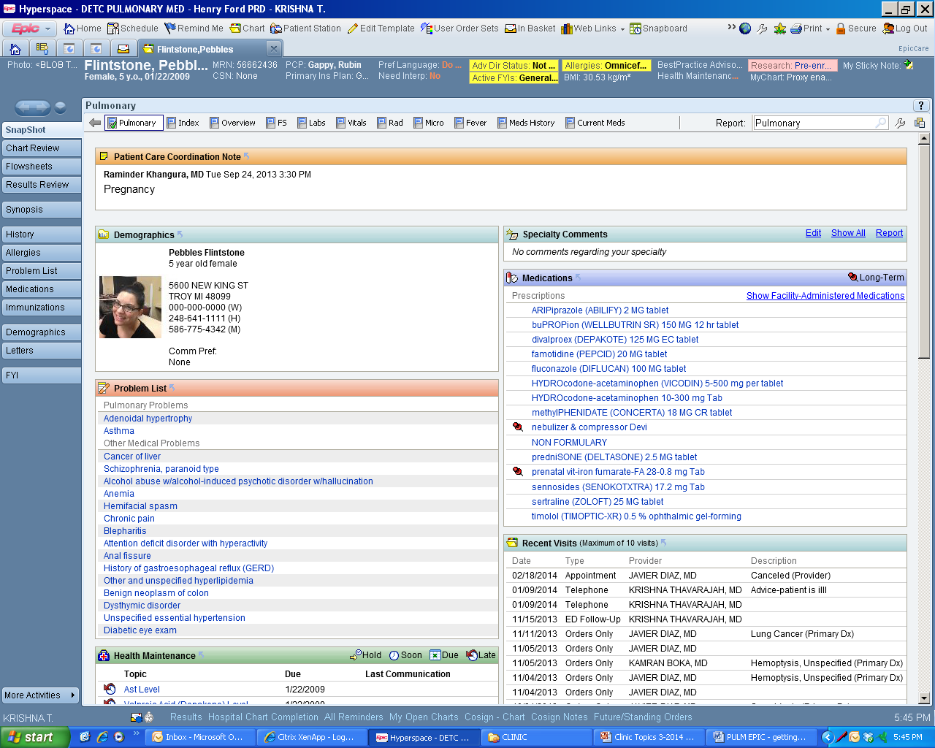

Slide 2
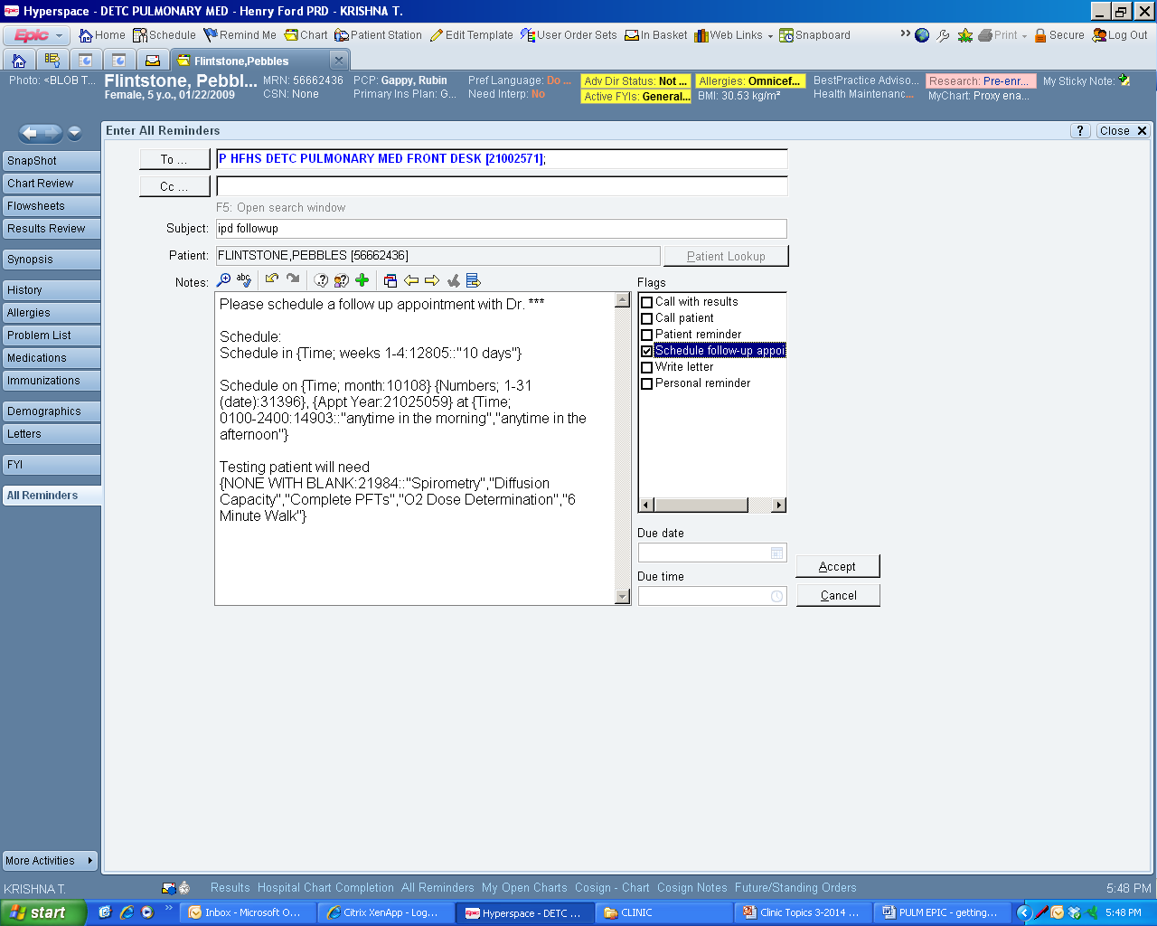
Smartphrase:
“.F2” provides template of information needed

