Slide 1
POST-ICU CLINIC

Slide 2
Neuropsychiatric Symptoms of PICS
Cognitive
Psychiatric
Behavioral
Executive functioning
Attention
Memory
Anxiety/PTSD
Depression
Psychosis
Sleep change
Aggression
Apathy

Slide 3
Post-ICU Outcomes are Poor
1 in 3 patients with >48 hours in the ICU do not go back to work
Another 1 in 3 don’t go back to pre-ICU job or salary
1 in 4 patients require assistance in activities of daily living a year after ICU admission
Half of families have to make major adjustments to their lives
These impairments in physical, mental, or emotional domains can persist 5-15 years after ICU admission. They are called “Post-ICU Care Syndrome” or PICS
Notes:
The major risk factors associated with PICS are
duration of delirium in ICU, acute brain dysfunction (stroke, alcoholism), hypoxia (ARDS, cardiac arrest), hypotension (severe sepsis, trauma), glucose dysregulation, respiratory failure requiring prolonged mechanical ventilation, severe sepsis, use of renal replacement therapy, and acute respiratory distress syndrome (ARDS), prior cognitive impairment (older age, preexisting cognitive deficits, premorbid health conditions).
https://healthmanagement.org/c/icu/issuearticle/infographic-6

Slide 4


PICS Clinic
Embedded within Neuropsychology Department
Need for specialized services for all patients discharged from ICU
Specific syndrome: Post-ICU Syndrome (PICS)
Also affects caregivers of these patients; PICS-Family (PICS-F)
Increased need starting in 2020 with COVID-19 pandemic, surge in ICU stays
Need to reach underserved populations; provide high quality care

Slide 5
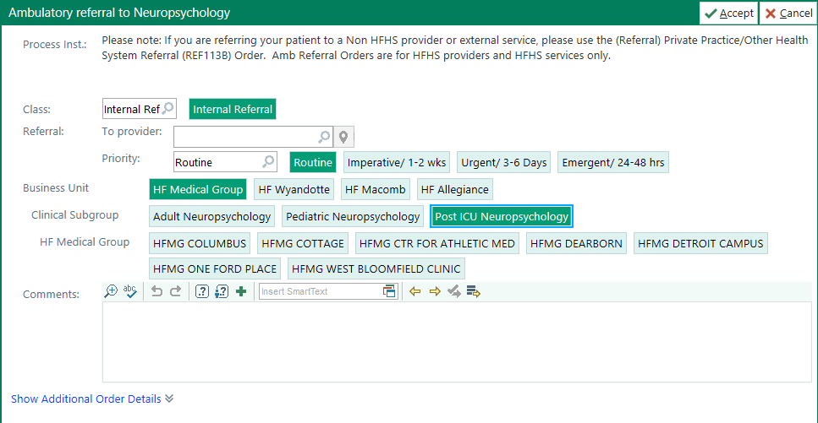

Slide 6
How to make referrals and EPIC Smart phrase
Email - Post-ICU Neuropsych referrals Post-ICUNeuropsychreferrals@hfhs.org
Call – 313-874-4846
EPIC Order
Include in discharge paperwork the following smartphrase
  .posticubrain

Slide 7
Smart Phrase Info
Post-ICU Brain Health Clinic
Specialized services through Henry Ford Department of Neuropsychology are available for adults age 18+ who have been discharged from the ICU and are experiencing lasting cognitive and emotional difficulties following their ICU stay.
The HF Post-ICU Brain Health clinic provides services to individuals who are experiencing a syndrome known as Post-ICU Syndrome (PICS) and their families/caregivers.
Patients with PICS may experience changes in thinking, emotion, and behavior. These changes may impact their day-to-day functioning or your ability to work.
Family and caregivers may also experience stress, depression, anxiety, grief, and insomnia (sleep problems) after their loved one's hospitalization.
The clinic is open to adults 18 or older with any of these concerns. We offer comprehensive neuropsychological evaluations of cognition, emotion, and behaviors. We also offer treatment (individual therapy, cognitive rehabilitation, support groups) to those in need of these services.
We offer video visits and cognitive testing at our One Ford Place and at West Bloomfield Hospital locations.
To make a referral or to schedule an appointment with us:
Providers: In EPIC use REF47 and indicate Post-ICU clinic.
Email Post-ICU Neuropsych referrals to: Post-ICUNeuropsychreferrals@hfhs.org
Patients or employees can call 313-874-4846

