Slide 1
Step by Step Guide to Non-Invasive Orders
This is a how to guide to search for sleep studies and to order noninvasive ventilation.

Slide 2
Ordering process when patient requires Non-invasive therapy.
The provider will review the following information for a patient that requires nocturnal support.
Verify whether the patient has their home unit and hoses, interface and power cord in good condition.
Home units need to be approved by Clinical Engineering prior to use CALL 164787
If the patient requires the use of a Henry Ford owned unit one will be provided if available by Respiratory Therapy call 313-694-9971 or HALO HFH RT Detroit Supervisor.

Slide 3
How to find the appropriate Noninvasive settings?
Patient noninvasive settings can be obtained by asking the patient or by searching for sleep study recommendations. (Assess patient for appropriateness of settings before ordering)
To search for sleep study recommendations, go to EPIC chart review and look for sleep study or sleep notes.
The sleep study will contain the noninvasive mode and settings. Instructions may be included.

Slide 4
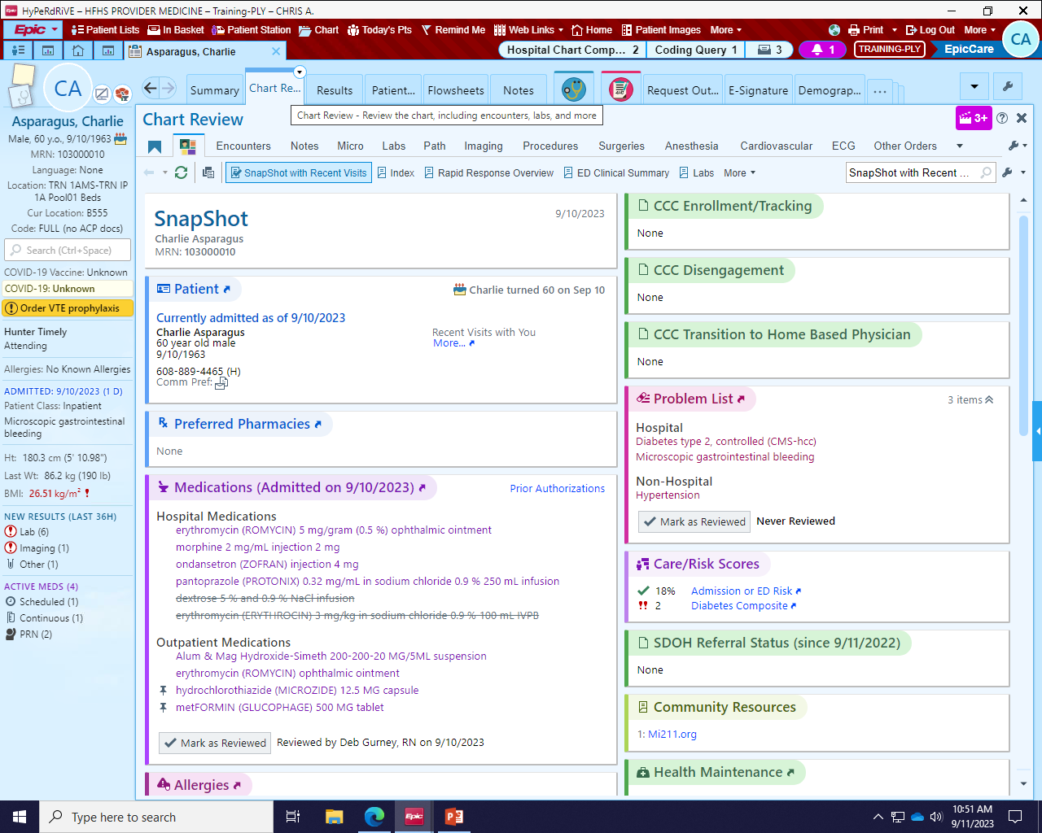
To obtain sleep study or sleep notes performed at Henry Ford Health System open patient record and go to the following tabs: 1. Summary 2. Chart Review

Slide 5
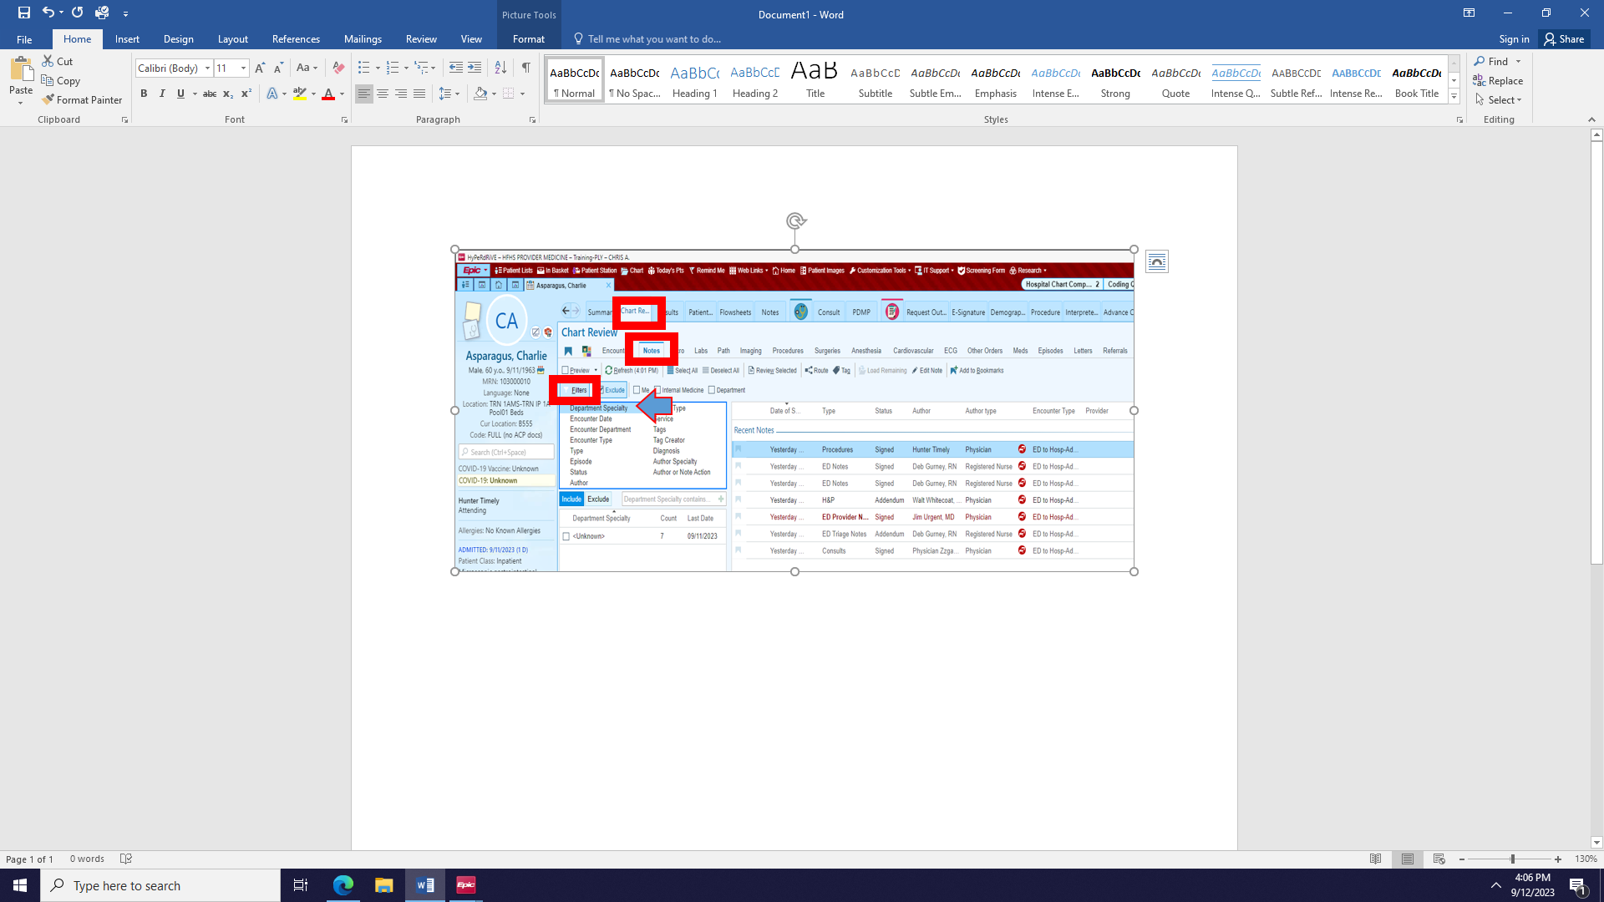
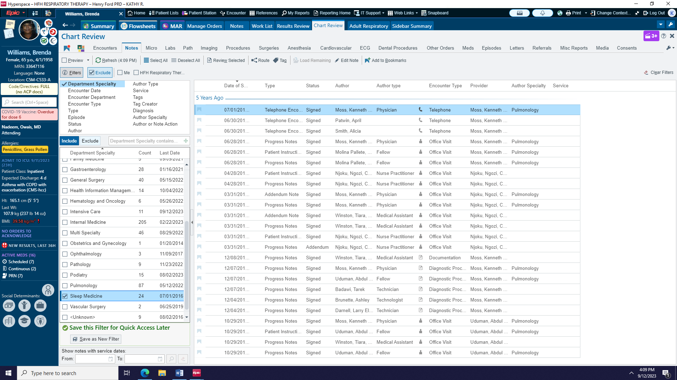
3. Once in Chart Review click on Notes 4. Filter notes by Department Specialty 5. Select Sleep Medicine from alphabetical list of departments

Slide 6
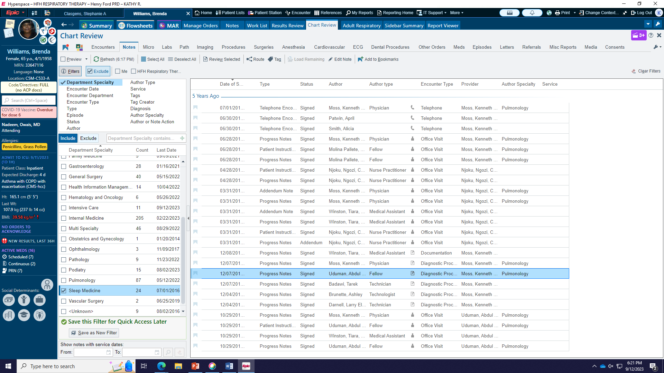
All encounters related to sleep department will appear on the right side of the page. Sleep study will be listed as a Diagnostic Procedure.

Slide 7
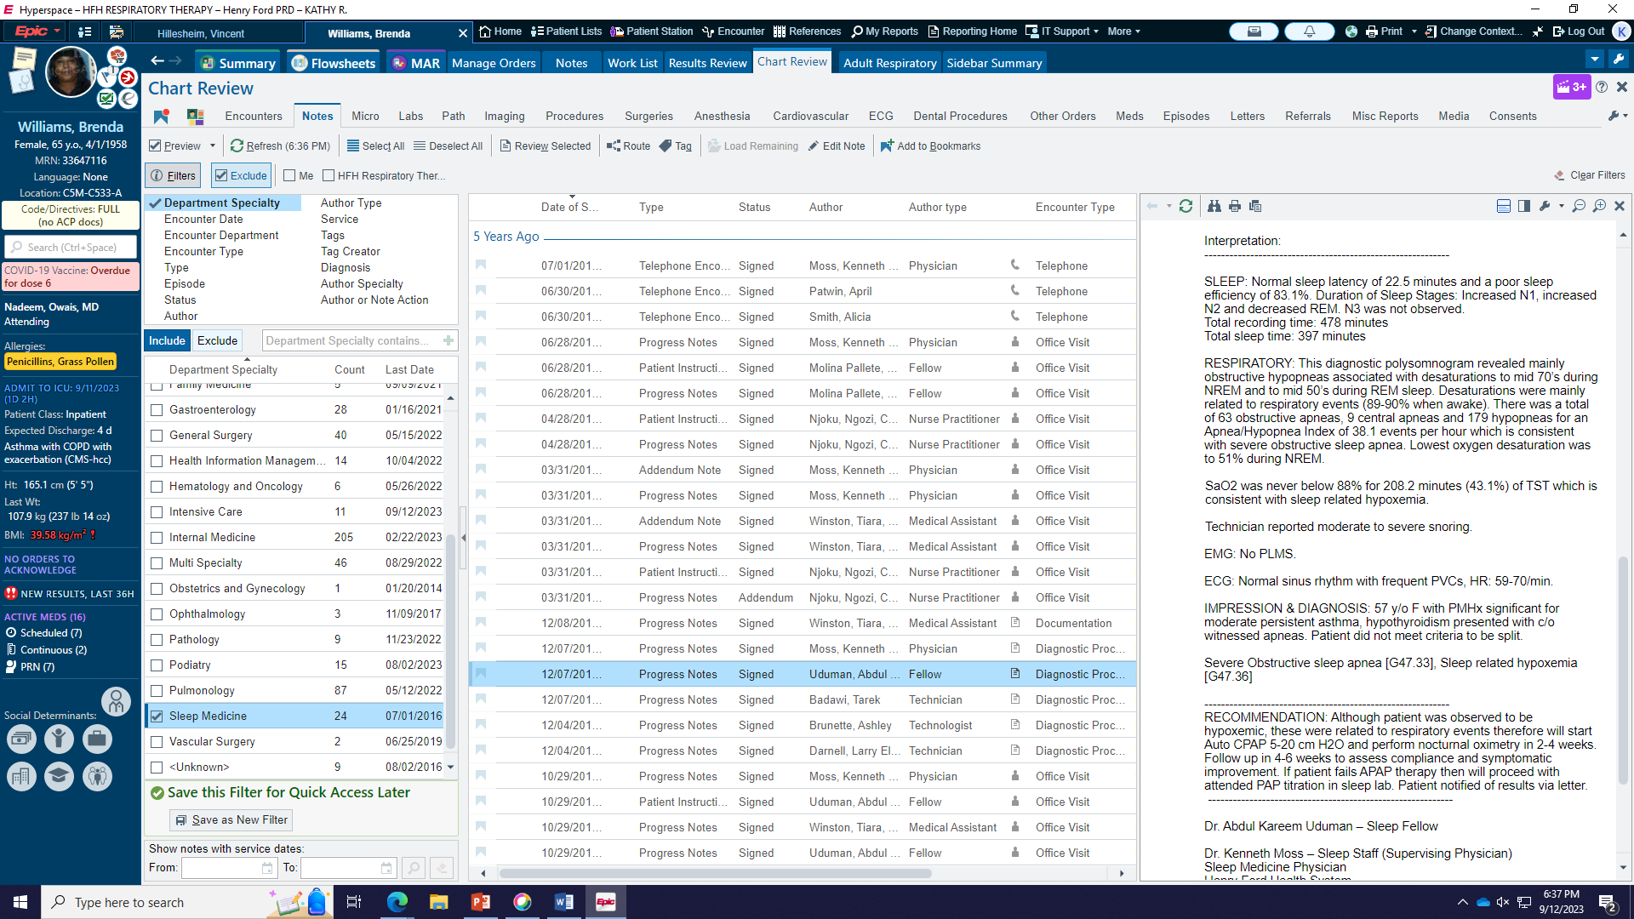
The sleep study is highlighted below. Study will appear with recommendations once opened. If no sleep study is found, study was most likely not performed at HFHS.

Slide 8
If no sleep study is found but patient reports use of CPAP/BiPAP home machine:
Request a family member or friend bring the patients home unit to the hospital for the patient.
Ask patient for home settings, if patient doesn’t know Provider can find out where the sleep study was performed OR name of home care company to get the patient’s settings. (check patient’s home machine for home care company information)
Appropriate MODE must be ordered in the event patient has hypoventilation syndrome and may need BiPAP with/without a back up rate
If unable to find settings and patient doesn’t know or patient has not had as sleep study order determine if patient needs BIPAP or CPAP then order Auto BIPAP or Auto CPAP.
Remember, something is NOT better than nothing if the therapy is incorrect.
Sleep medicine can be consulted for assistance.

Slide 9
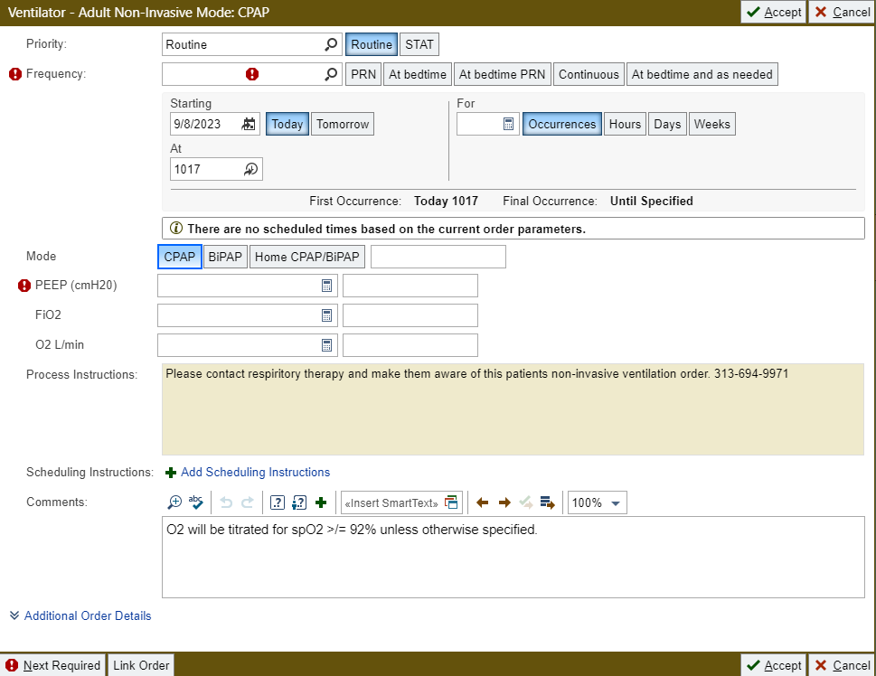
CPAP Order

Slide 10
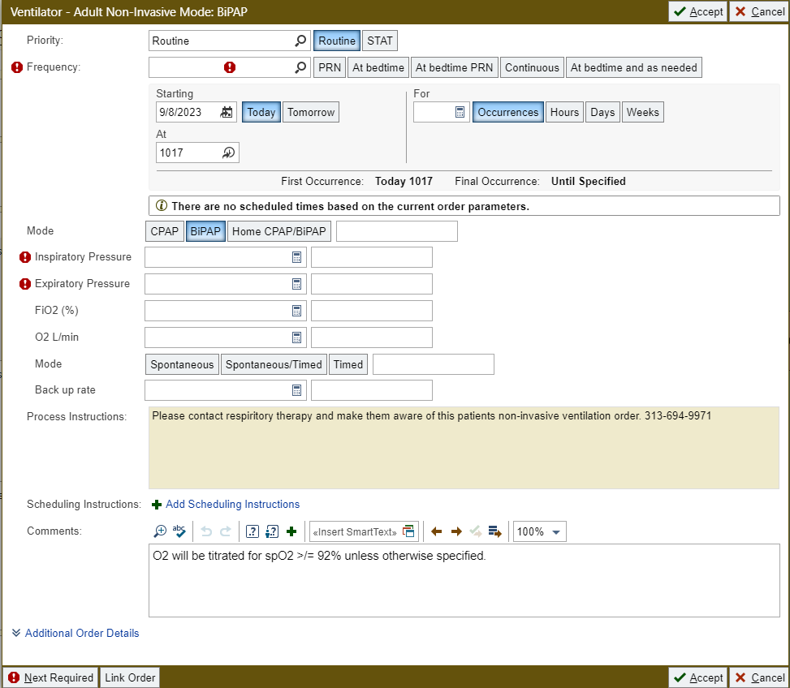
Bipap Order

Slide 11
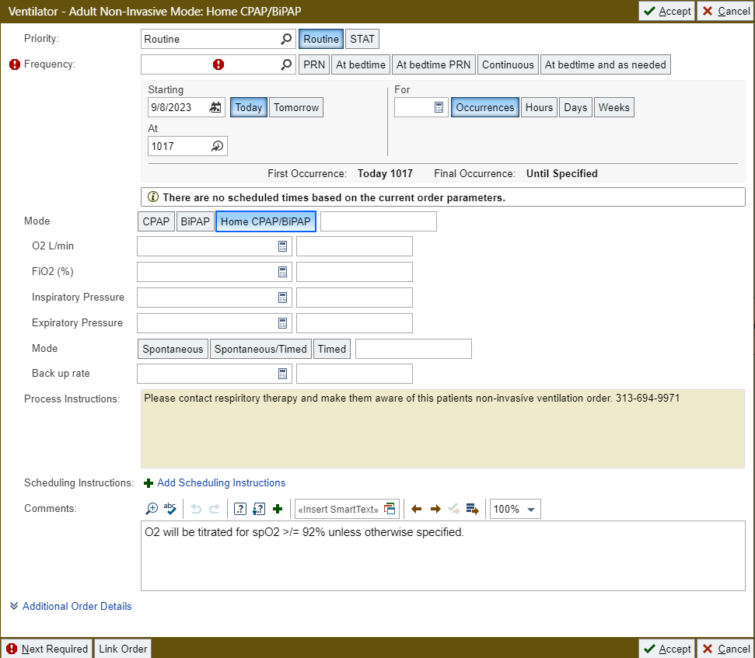
Home Noninvasive Order

Slide 12
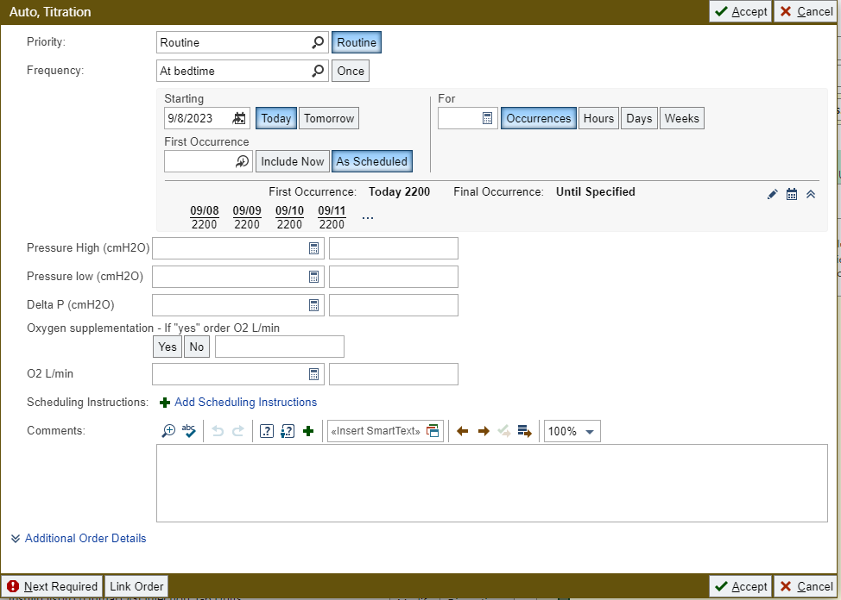
NIV Auto Titration Order

Slide 13
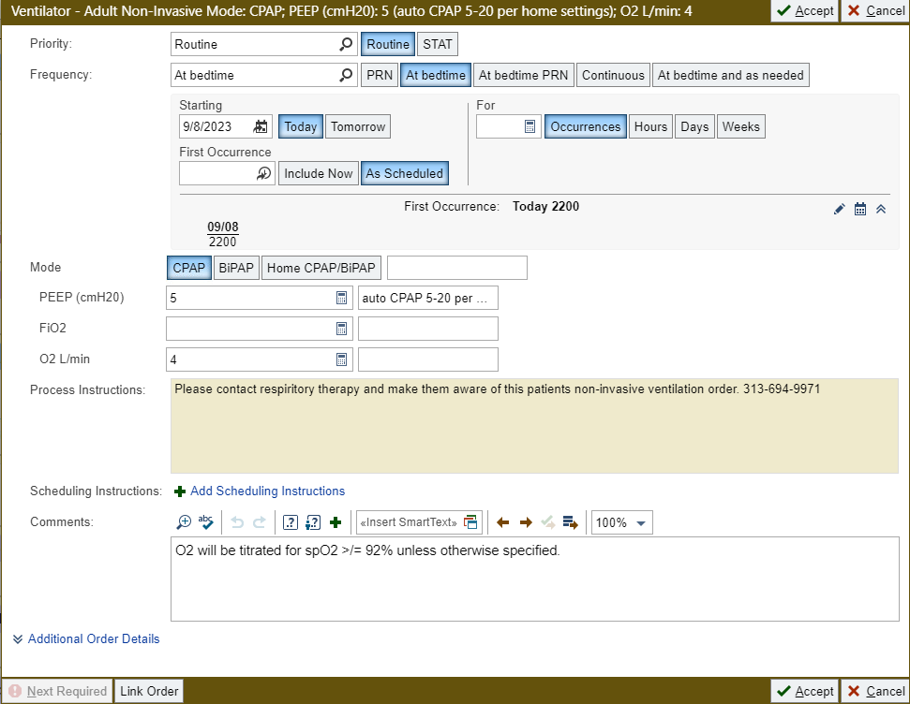
NIV AUTO CPAP/ AUTO BIPAP Order the Adult NIV order and in the comment section type AUTO CPAP with settings or AUTO BIPAP with settings

Slide 14
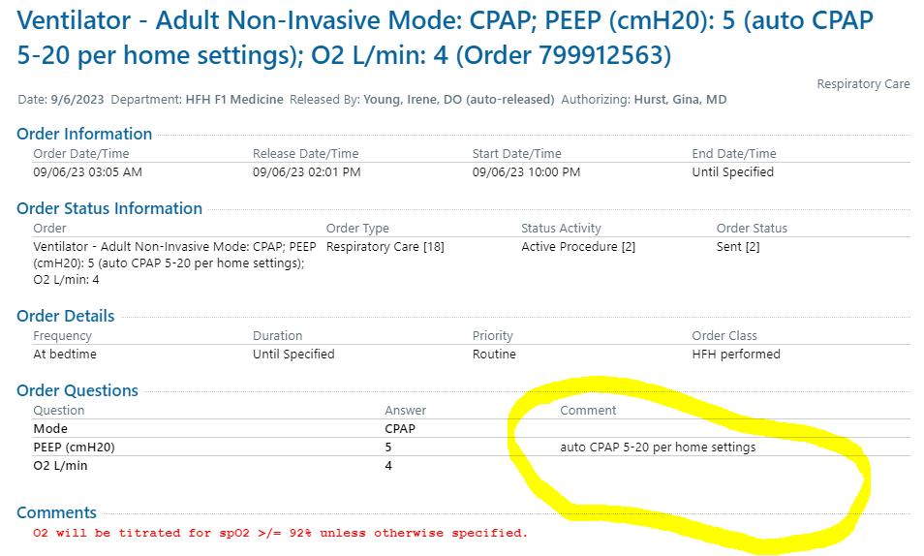
NIV Auto CPAP/ AUTO BIPAP

Slide 15
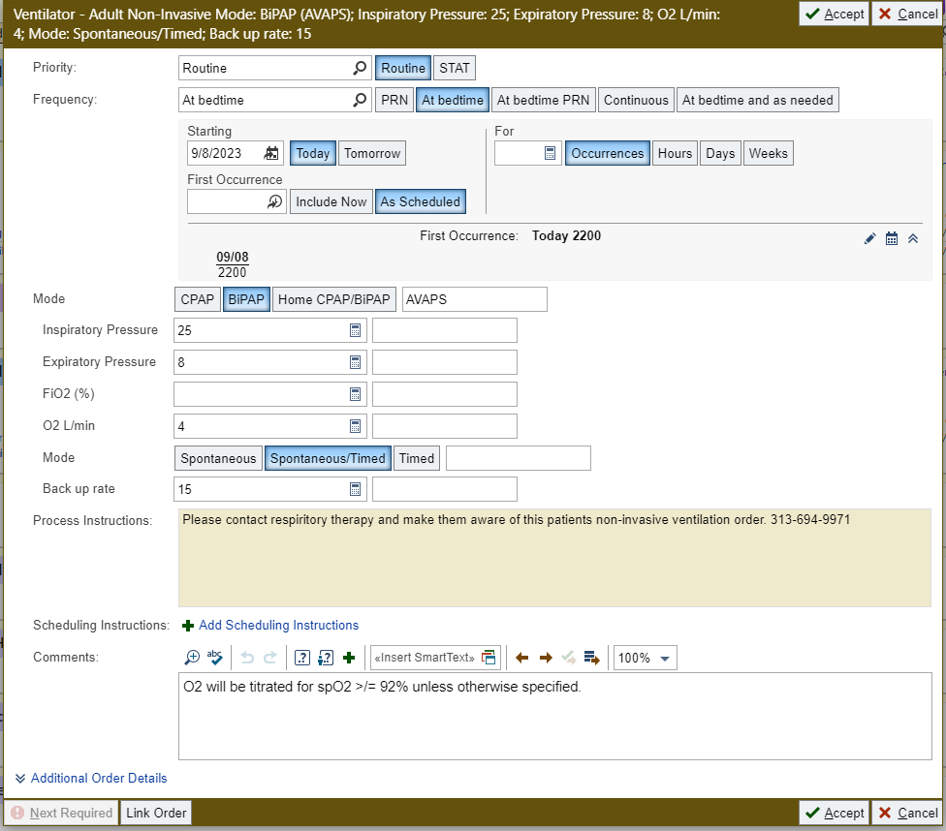
Adult NIV AVAPS Order the Adult NIV order and in the comment section type AVAPS with settings

Slide 16
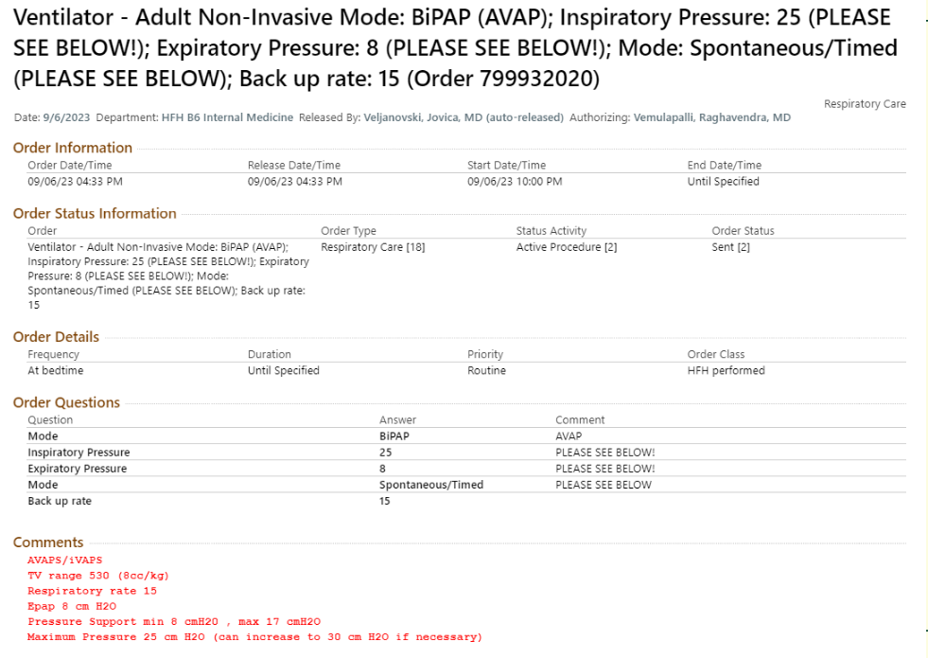
AVAPS

