Slide 1
ICU Orders & Templates
Updated: 2/25/2021

Slide 2
Admissions

Slide 3
Assigning Patients in Epic
Assigning Patients to Teams
  In patient list/floor list view, R click on patient
  Select “assign teams”, type team name
    MICU WHITE (POD 1+3), RED (POD 2+3), or BLUE (POD 4)
Assigning Staff to Teams
  In patient list/floor view, click circle with dots in R upper corner
  Select “define teams”, type in team member names

Slide 4
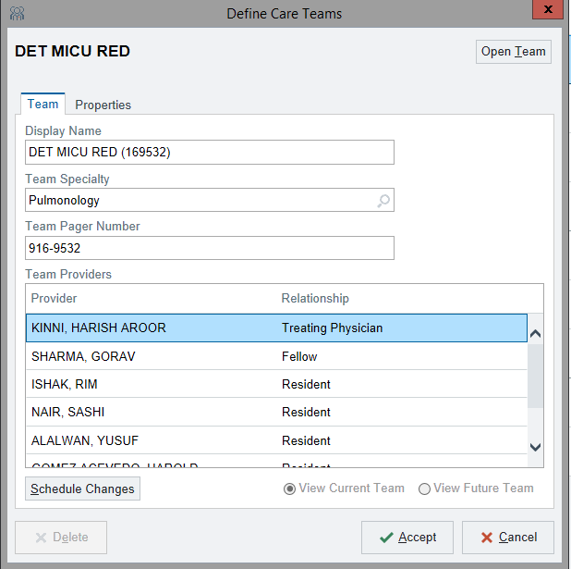
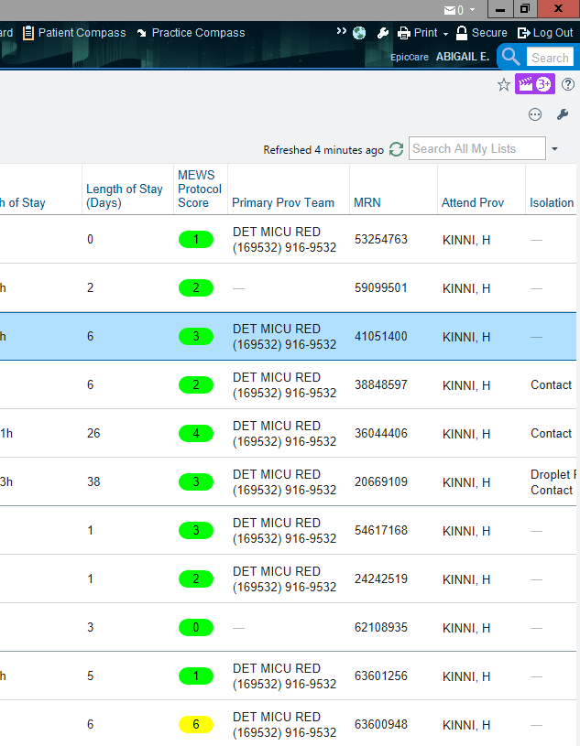
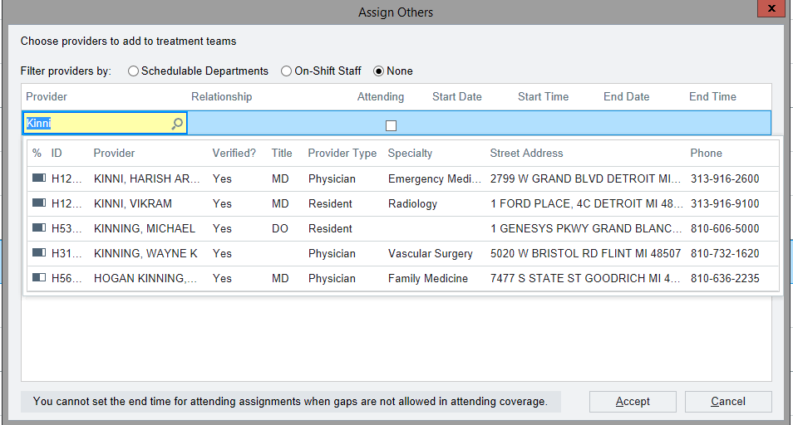

Slide 5
General Admission Orders
Open patient chart, go to “Admission” tab, select “Order Rec-Sign”
  “Review Current Orders”- orders will be here if patient was transferred from floor or admitted from ICU- you can discontinue or reorder
  “Review Home Medications”
  “Reconcile Home Medications”
  “Order Sets”
    Under this tab, type in “Medical ICU” in the text/order box on R
    Select MICU admission order set
    Go through order set, indicates hard stop (must be addressed)
    DON’T MISS
      Admission order
      Code status
      Diet
      Vent Order
      PT/OT
      Glycemic Protocol
      VTE ppx
      Electrolyte protocol (if Cr <2.5)

Slide 6
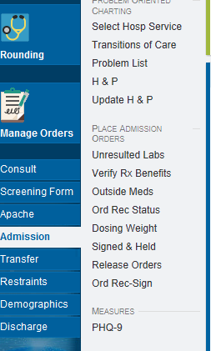
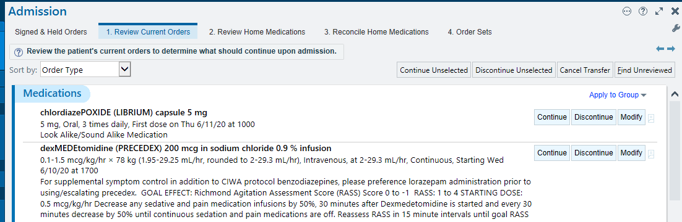
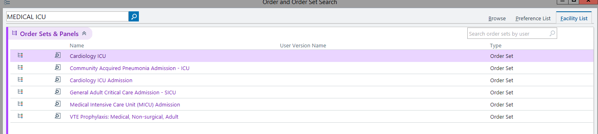

Slide 7
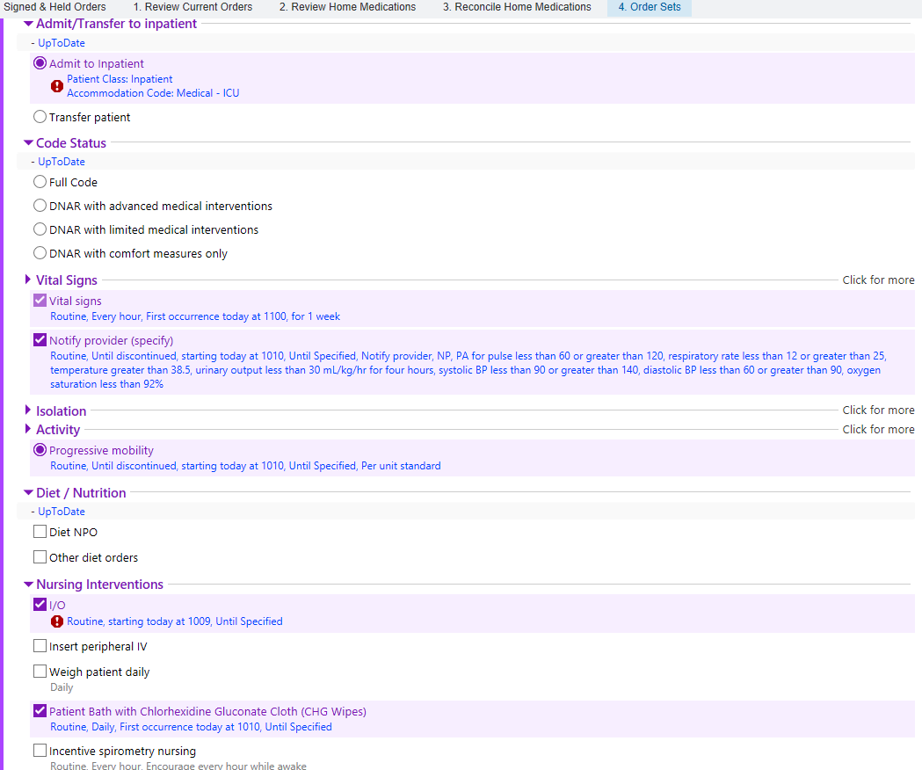
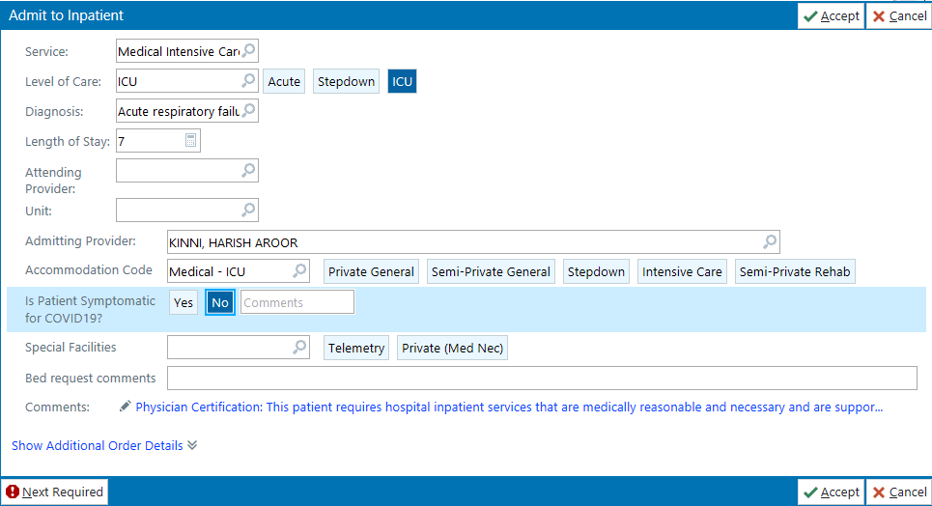

Slide 8
Ventilator Orders
Order ventilator WITH BUNDLE
  Pairs with VAP and GI ppx
Changing Vent Orders
  When vent settings are changed or weaned by RT, order must be updated in EPIC
  Go to “Manage Orders” tab on L side
  Scroll down to vent order (usually all the way at bottom)
  Select “modify”, change orders, “accept”

Slide 9
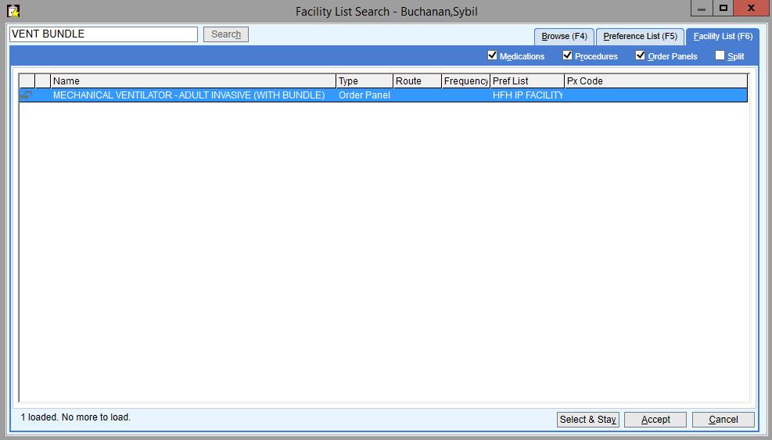
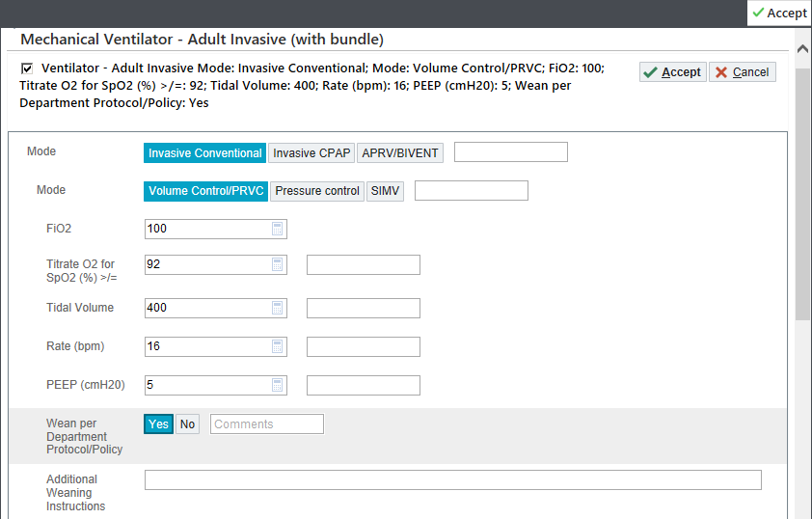
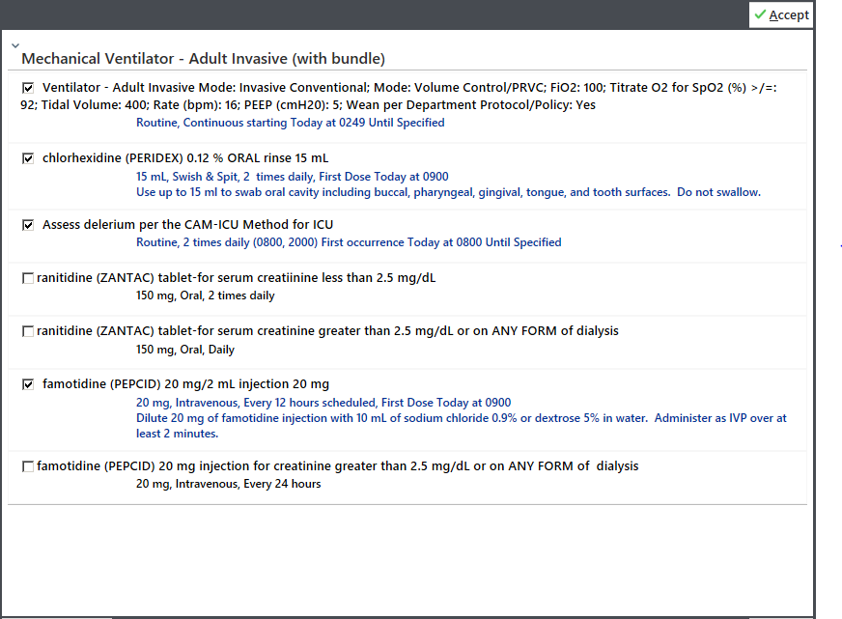

Slide 10
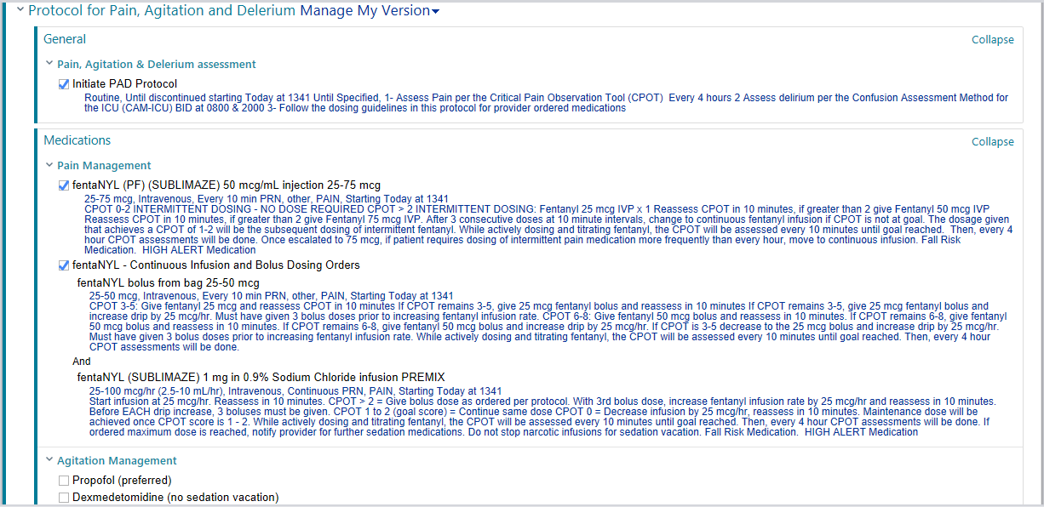
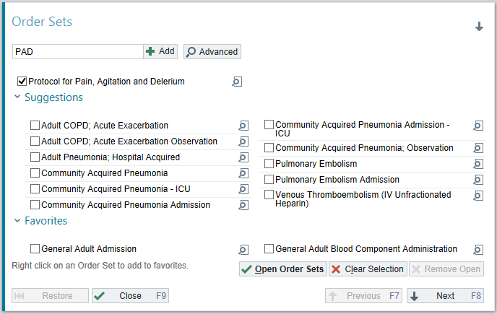
PAD Protocol
Pain-Agitation-Delirium protocol for intubated patients

Slide 11
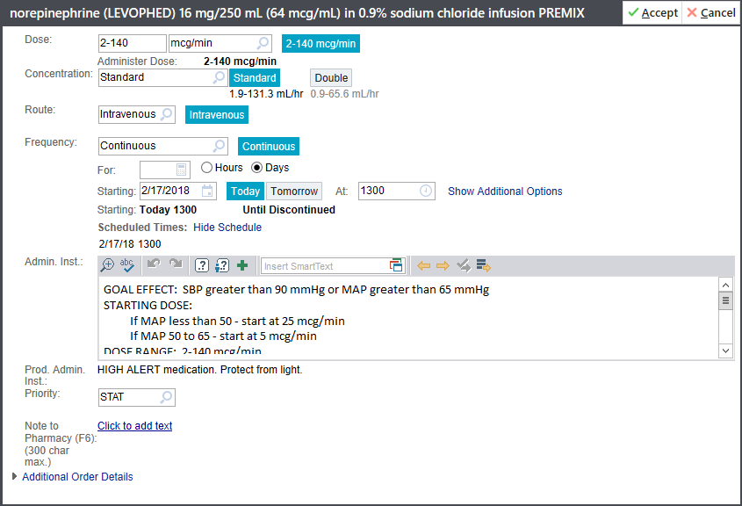
Notes:
Take note of administration instruction. Can adjust goal effect in right context. In certain patients with cirrhosis with chronically low BP, MAP 60 may be appropriate goal or simply a SBP target of > 90.

Slide 12
Transfers

Slide 13
Transfers-out
In orders, type “transfer patient”
  Fill out “Service” (Internal Medicine), “level of care”, and “Bed Request Comments” (Any GPU, telemetry, H2, F2, etc)
Don’t forget Transfer Note
Call report once bed assigned
  Strongly recommend adding “Bed Request Status” to your team list so that you know when patients are assigned for transfer
  Nursing communication and call/in person communication when report called
Reminders about GPUs
  Cannot be on insulin drips, hypertonic saline
  Trach’s must be Uncuffed
  Cannot require lab draws or medication administration more than q3hours

Slide 14
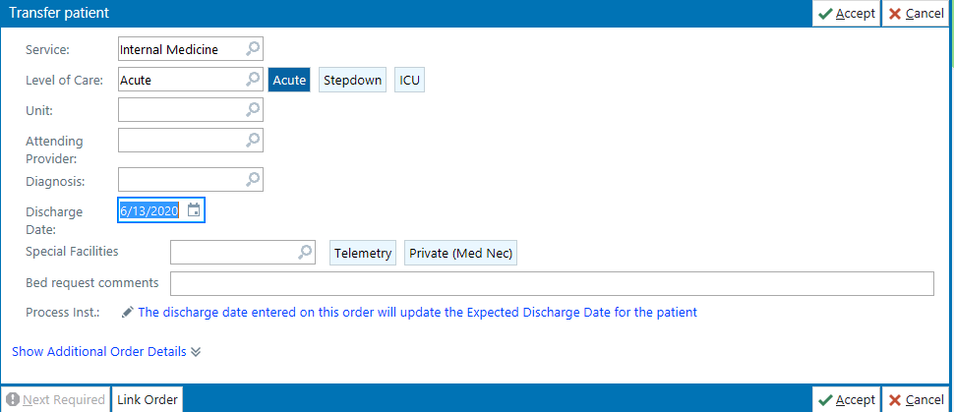
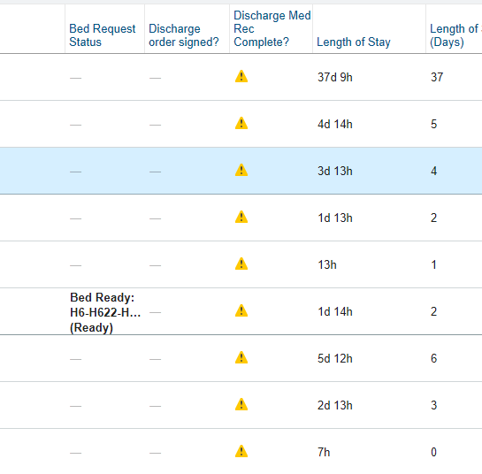

Slide 15
Discharges

Slide 16
Discharges
To SNF
  Med Rec:
    “First fill”- the facility needs 3 days worth of all medications (send to discharge pharmacy), plus controlled substances must be paper prescriptions *Case management will know whether the facility is a first fill*
    Not first fill- give paper prescriptions or order all medications as “no print”
  Discharge Order
  Discharge Summary
    Update the Hospital Course
    Update the problem list
    Must be complete prior to transfer (printed version goes with patient)

Slide 17
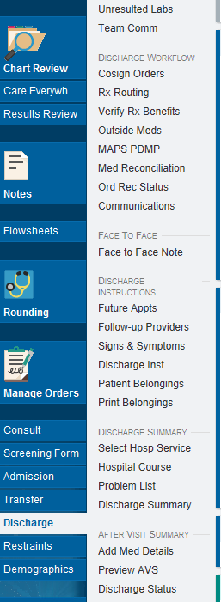
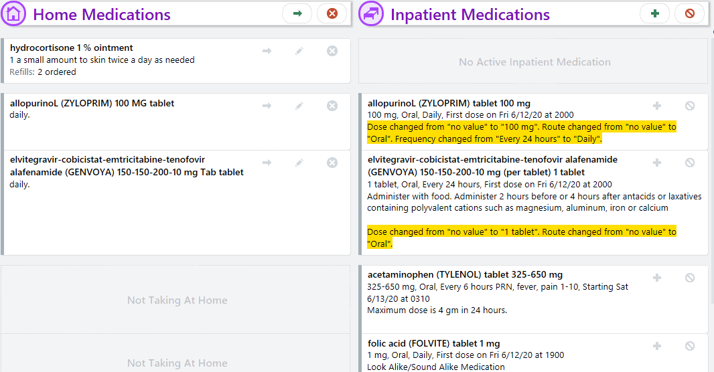
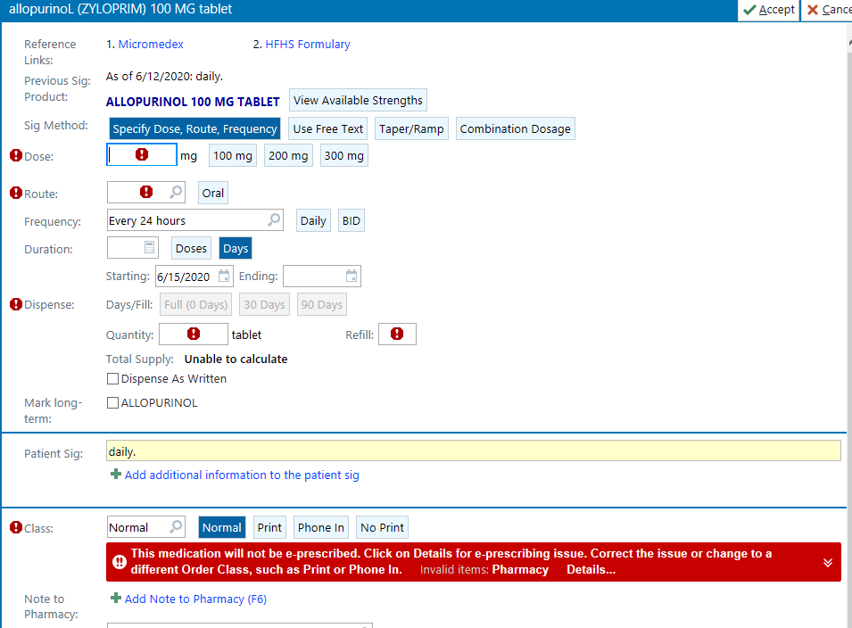
Continue- this leaves the medication on the MAR without providing refills
Change- this allows you to adjust the medication dose or frequency and also provides refill
Discontinue- removes medication from MAR

Slide 18
Discharges
As deceased
  IMPORTANT DOCUMENTATION:
    Date/Time of Death
    Post Mortem Doc
    Once these two tabs are filled out, RN can print the documents
    Once printed, you must do the Autopsy form with the family:
      You do not sign anything, but family does regardless of autopsy status
  Sign discharge order
    Discharge condition= deceased/expired

Slide 19
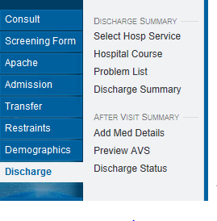
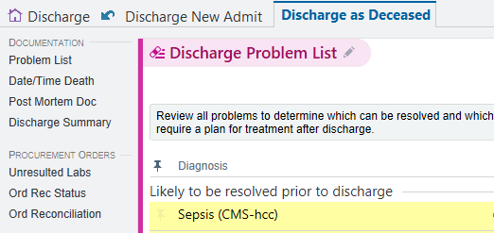
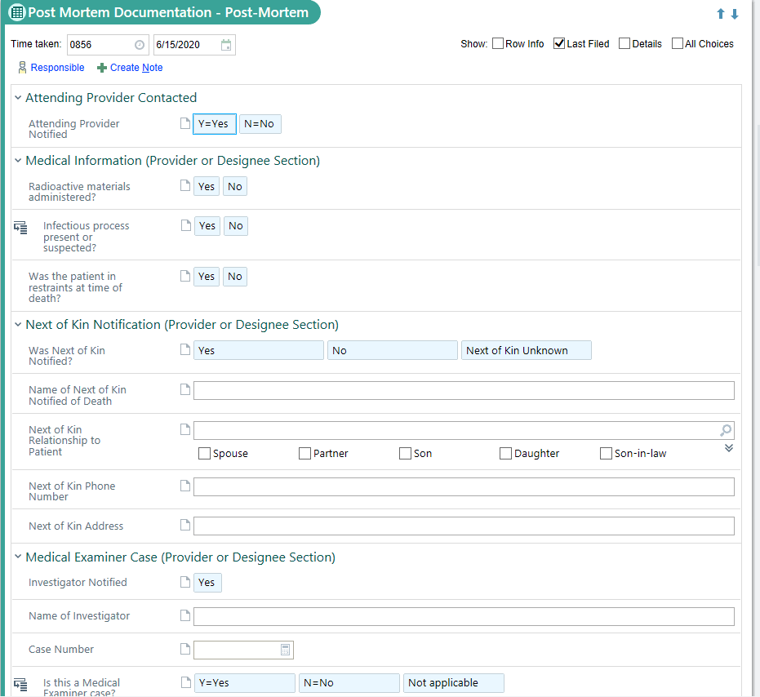
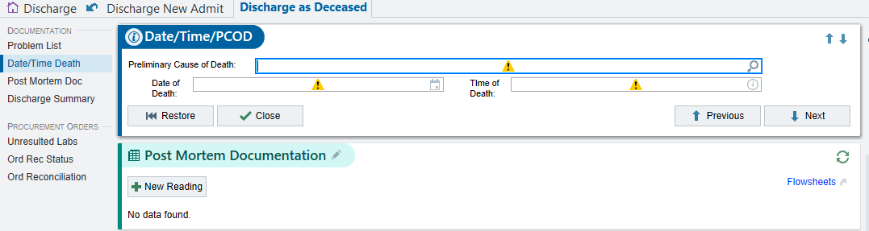

Slide 20
Rounding Pearls

Slide 21
Rounding Pearls
Overview Tab
  Avitar
    Hover over lines to see how long they’ve been in
Index
  Can find blood transfusion history here
Comprehensive Flowsheet
  Can review most vitals/vent settings
Intake/Output
Other Flowsheets
  Ventilator Weaning
  CIWA
  Dialysis

Slide 22
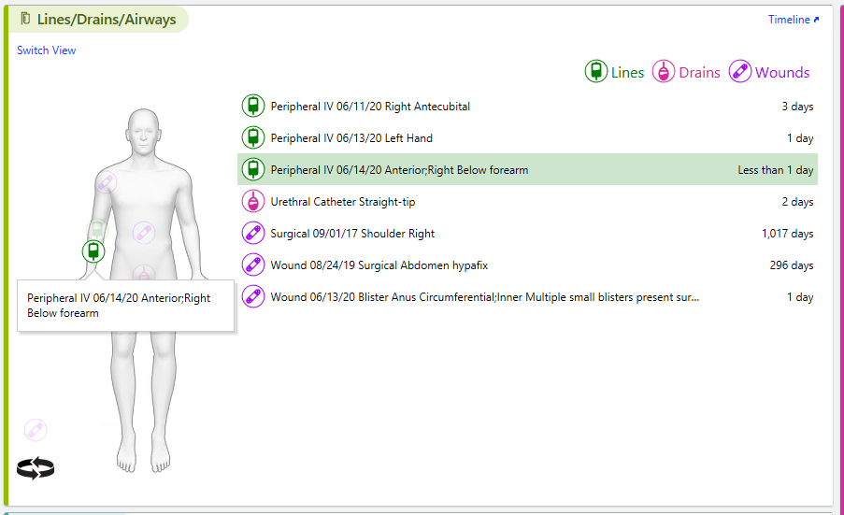
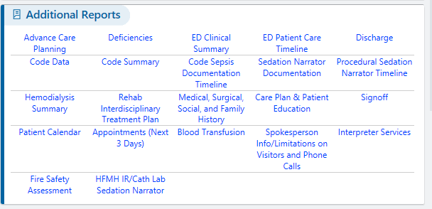
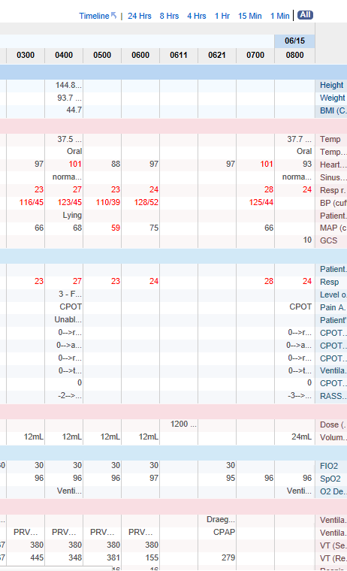
You can find transfusion history under INDEX
Avitar for lines
CompFS gives you vitals and vent settings
Fever- gives nice fever curve along with abx history for each day and trends WBCs
Meds History- can review what meds were given (or not given but ordered)
Glucose- trends glucose and gives record of all insulin given
I/O- can sort by different increments (ie 24 hours)

Slide 23
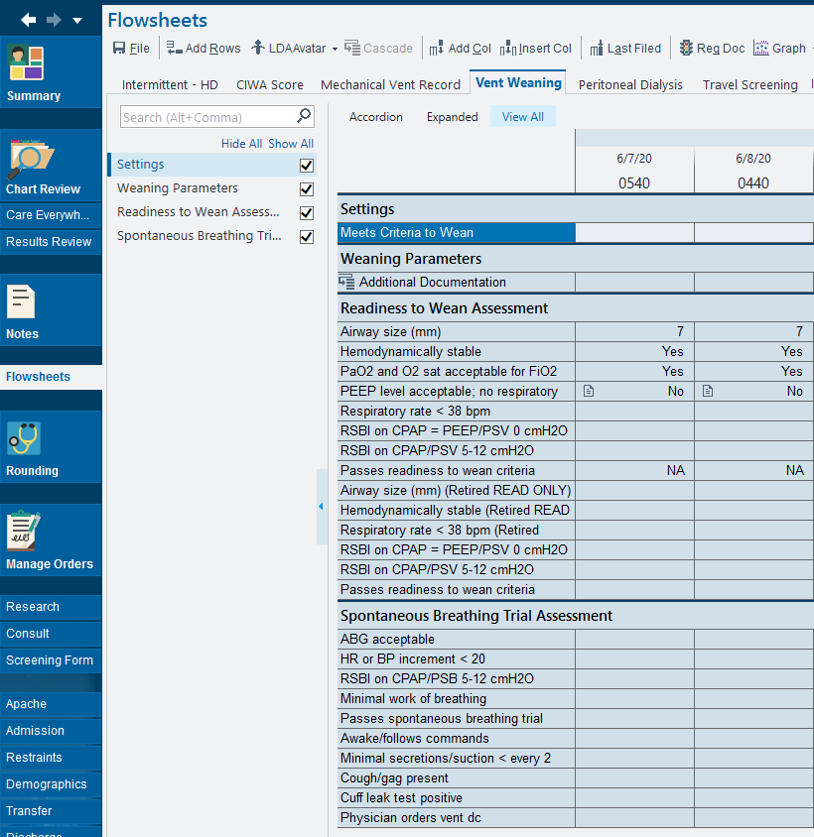
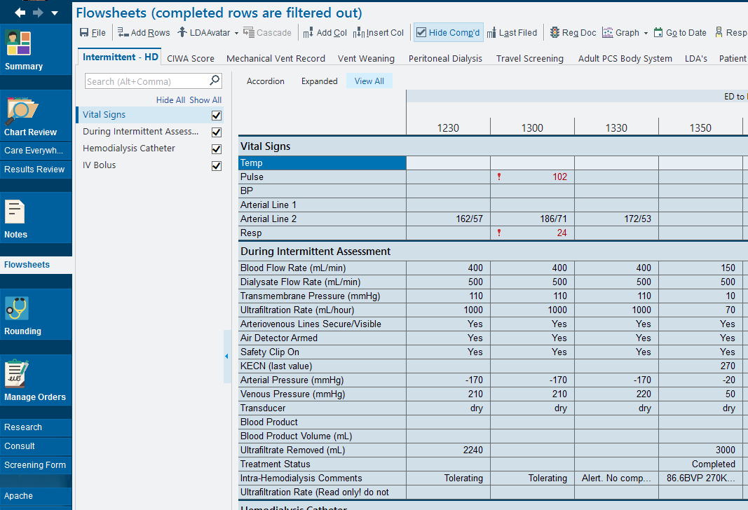
Under “FLOWSHEETS” you can save some useful tabs
-Intermittent-HD can show you how dialysis went/how much UF was taken off
-CIWA tracks CIWA scores
-Vent Weaning will show you where to find your RSBI etc

Slide 24
Restraints
New order
  “Restraints” -> “Restraint Order”
  Select the type of restraints, sign order
  Do “Face to Face”
Renewing restraints
  Every calendar day, restraints must be renewed
  “Restraints” -> “Face to Face”

Slide 25
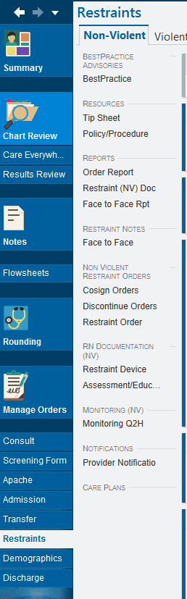
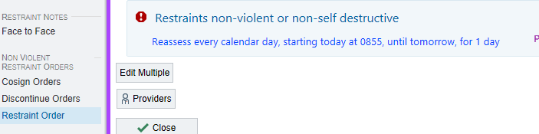
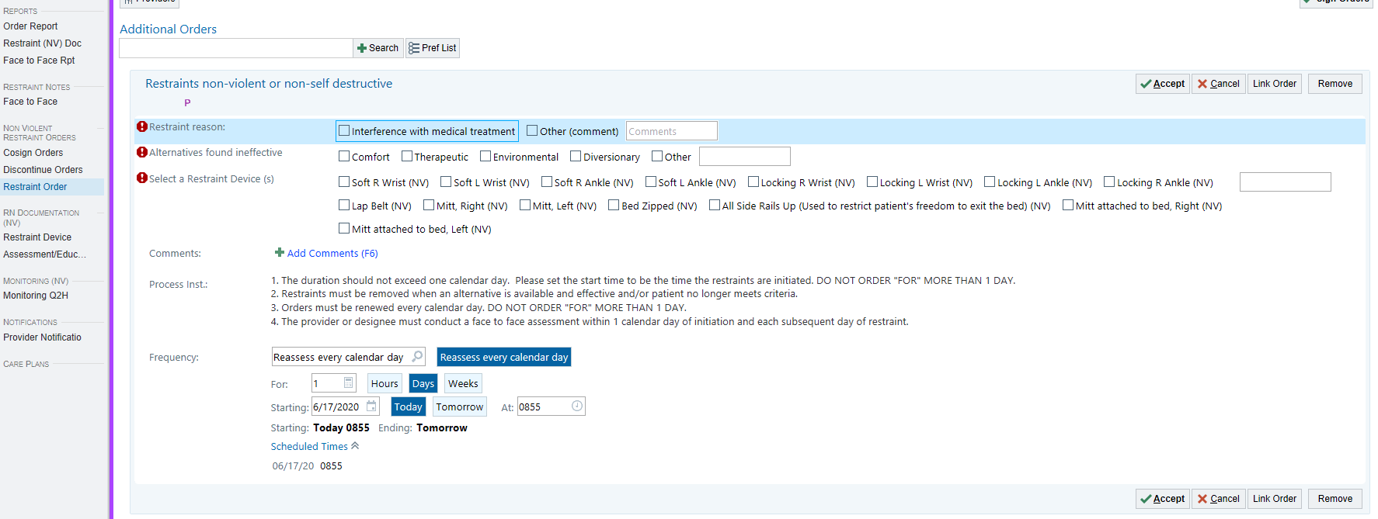
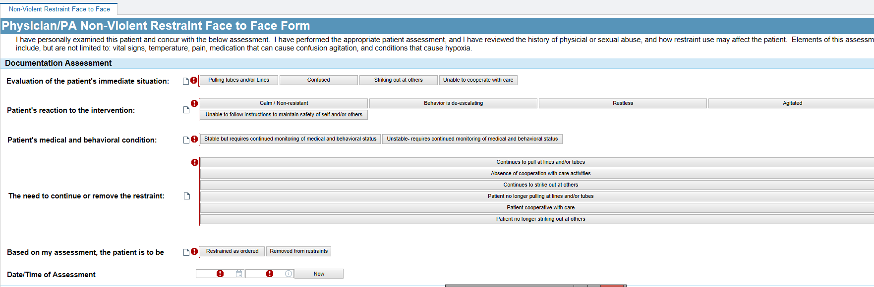

Slide 26
Notes

Slide 27
Notes (use the templates!)
History of Physical Examination
1. .HFMICUHPVENTED (for intubated patients)
2. .HFMICUHPNONVENTED (for patients not on the ventilator)
New Progress Notes
1. .HFMICUPROGRESSNOTEVENTED (for intubated patients)
2. .HFMICUPROGRESSNOTENONVENTED (for patients not on the ventilator)
Transfer Notes, are for transfer acceptance. Again, please use the provided note form by erasing the template that comes up when you start a transfer note, and then use the following dot phrases now shared in your epic smart phrase list.
1. .HFMICUTRANSFERVENTED (for patients transferred in or subsequently intubated prior to your note time)
2. .HFMICUTRANSFERNONVENTED (for patients not on the ventilator)

Slide 28
Note
Generate through “NOTES” tab
    FIRST, go to “Rounding”, “Problem List”- update all of the problems on the problem list (each problem must be updated each day)
    Click on “Notes” -> “New Notes” -> select the Type (H&P, progress note), type the desired dotphrase (see previous slide)
    F2 through the note to update the hard-stops

Slide 29
Consults/phone numbers

Slide 30

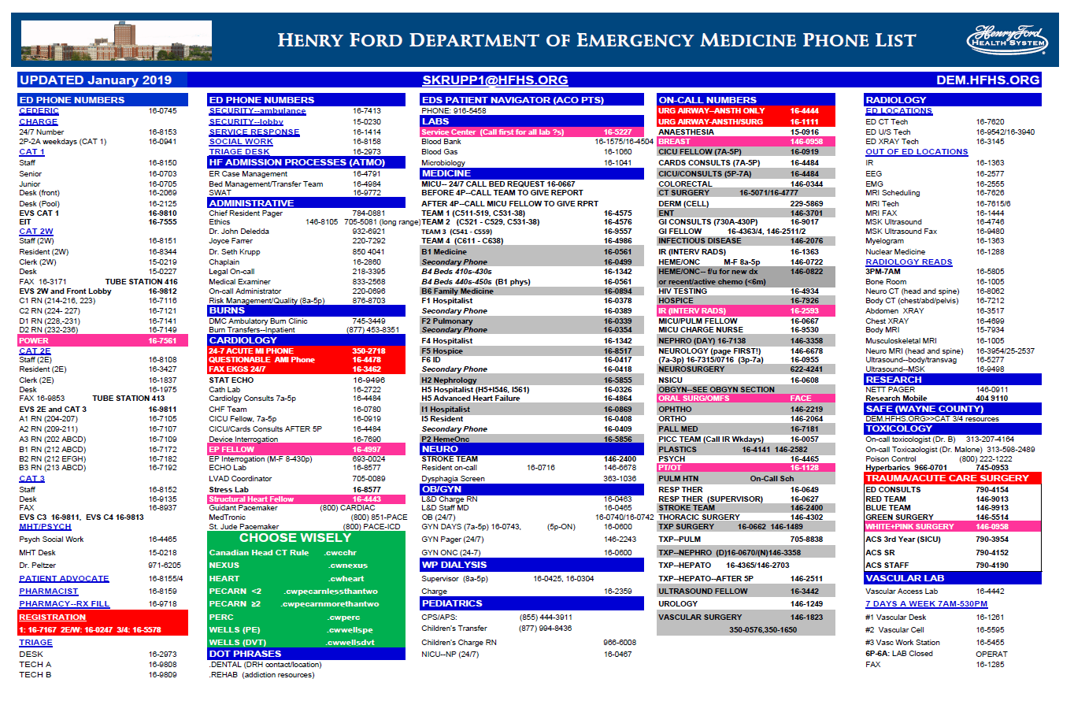
Use Halo for majority of consults and communication with teams
Dem.hfhs.org->phone directory
  Has numbers for radiology, GPU admission/report etc

